Slide 1
Redistricting 2022
Presented by
Kevin DeVriendt
Carlton County Auditor-Treasurer

Slide 2
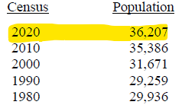
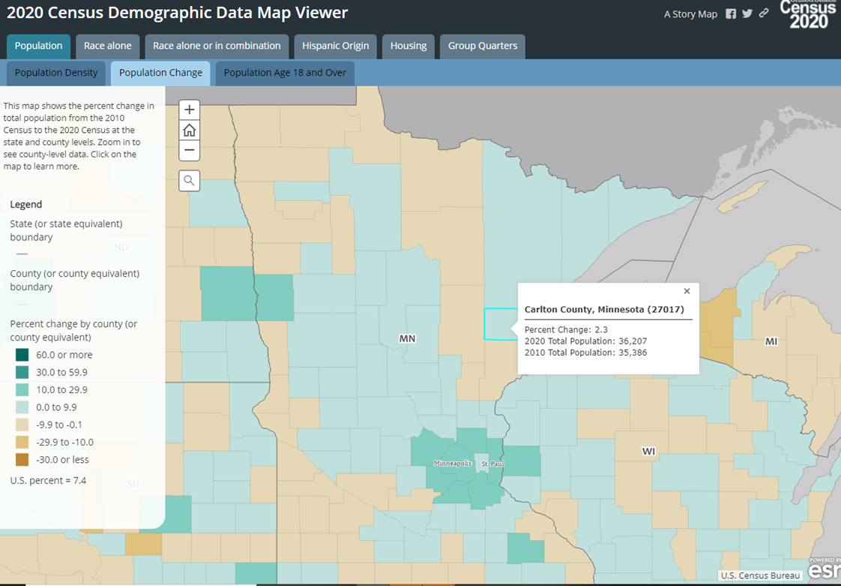
Population Changes
821 2.32%
3,715 11.73%
2,412 8.24%
-677 -2.26%
Minnesota
2020 5,706,494 7.59%
2010 5,303,925 7.81%
2000 4,919,479 12.44%
1990 4,375,099 7.34%
1980 4,075,970

Slide 3
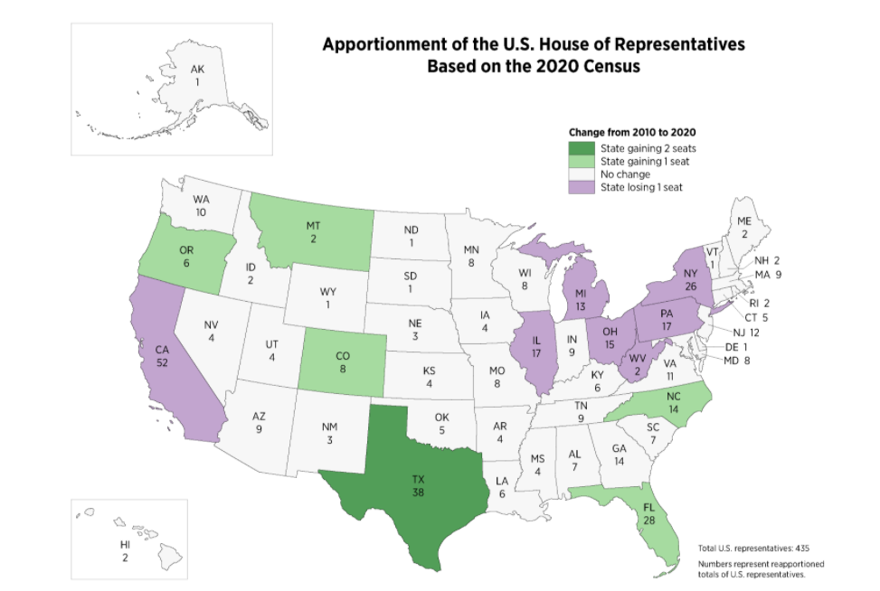
2020 Apportionment Outcomes

Slide 4
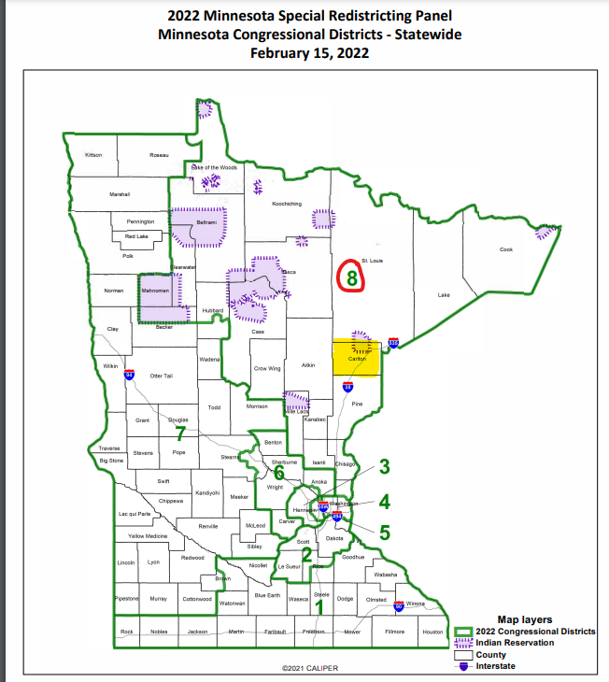
Redistricting of Congressional Districts
Carlton County remains in 8th the Congressional District

Slide 5
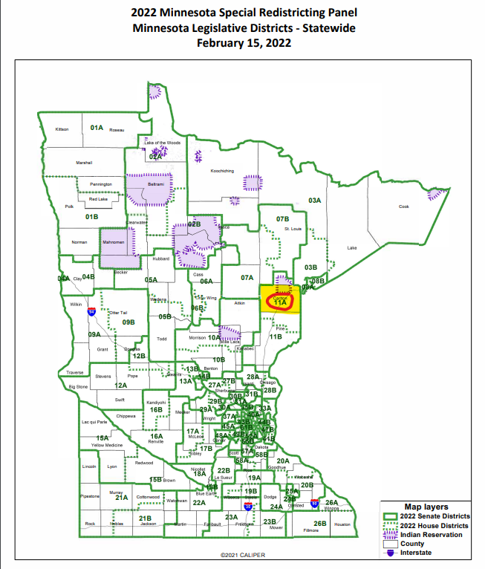
Redistricting of State Legislative Districts
Carlton County remains in MN House 11A and MN Senate 11

Slide 6
What is Redistricting?
Redistricting is the process of redrawing the boundaries of election districts, done in the United States after the completion of the decennial Census.
The purpose of redistricting is to ensure that the people of each district are equally represented.

Slide 7
Who Does Redistricting in Minnesota?
Legislature: congressional and legislative districts (courts if deadlines not met)
City council: wards and precincts
-CLOQUET (no Ward Changes) -CARLTON (annexation of Justice Center)
Township boards: precincts -TWIN LAKES
School board: school board election districts
County board: commissioner districts
Consider Soil & Water Conservation Districts if necessary – No implications in Carlton County
Notes:
-----------------------------------------------------------------------------------------------
-----------------------------------------------------------------------------------------------
-----------------------------------------------------------------------------------------------
-----------------------------------------------------------------------------------------------

Slide 8
Do you need to Redistrict ?
May be required if:
Precinct boundary that was a commissioner district boundary is no longer there
Annexations have created non-contiguous district
District population varies by more than 10% from average
Majority of districts can’t have minority of population
County boards can choose to redistrict even if not required.

Slide 9
County Responsibilities
County governments must redistrict county commissioner districts after every federal census to meet the requirements in M.S. 204B.135. This redistricting may take the form of:
1. Reestablishing existing county commissioner districts, if they currently meet all statutory requirements, or
2. Drawing new county commissioner districts, to make them conform to the statutes.
Notes:
-----------------------------------------------------------------------------------------------
-----------------------------------------------------------------------------------------------
-----------------------------------------------------------------------------------------------
-----------------------------------------------------------------------------------------------

Slide 10
Statutory Requirements
Adjust election district boundaries following each federal census
Create election districts that are as equal in population as practical
Create election districts of compact, contiguous territory
Notes:
-----------------------------------------------------------------------------------------------
-----------------------------------------------------------------------------------------------
-----------------------------------------------------------------------------------------------
-----------------------------------------------------------------------------------------------

Slide 11
Commissioner District Plan
Will include:
District Description
District numbers
Election schedule to ensure staggered terms
Do not necessarily have to continue same pattern of terms.
Terms in Carlton County
Even Numbered Districts in 2022 (District 2 & 4)
Odd Numbered Districts in 2024 ( Districts 1, 3, 5)

Slide 12
Redistricting Schedule
Sept. 30,2021 Census data released (Detailed block population)
Jan. 2022 Legislative session begins
Feb 15, 2022 Congressional and legislative plans completed
March 29, 2022 Precinct & City redistricting deadline
April 26, 2022 County commissioner and other redistricting deadline
May 17, 2022 Filings open for state/county elect
Aug. 9, 2022 State Primary
Nov. 8, 2022 State General Election
*Three week public notice and hearing required
Notes:
-----------------------------------------------------------------------------------------------
-----------------------------------------------------------------------------------------------
-----------------------------------------------------------------------------------------------
-----------------------------------------------------------------------------------------------

Slide 13
County Commissioner District Requirements
As many Districts as Commissioners
Districts bounded by precinct lines
Contiguous territory
Regular and compact
10% Rule
Plan filed with Auditor

Slide 14
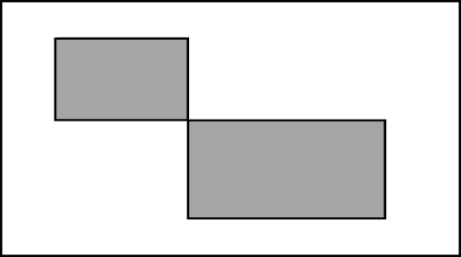
Contiguous Territory
Commissioner districts are composed of contiguous territory
Districts that are composed of areas that join each other at a single point are not considered contiguous.
Commissioner districts are to be as regular and compact in form as practicable

Slide 15
10% Rule
District populations cannot vary more than ten percent from the average for all districts in the county, unless the result forces a voting precinct to be split. (M.S. 375.025, subd. 1)

Slide 16
10% Rule Example with Carlton County info.
County population divided by commissioner districts x 10% = Threshold
36,207 / 5 = 7,241.4 average per district
7,241.4 x 10% = 724.14 Threshold
District 4 has a population of 7,565 (largest)
District 3 has a population of 6,871 (smallest)
The Variance is…………….. 694
Since the Variance of 694 is less than the Threshold of 724 no adjustment needs to be made.

Slide 17
Which Commissioners need to run?
If the seat’s normal 4 year term is up – Yes
2022- District 2 and 4
If the commissioner’s district has had a change greater than the 5% Rule.
If current boundaries change, then potential for others to run in 2022.

Slide 18
5% Rule
County population is 36,207 with 5 commissioners
Average Population is 7,241.4
The Threshold is 7,241.4 x 5% = 362.07
Dist. 1 had a pre-redistricting pop. of _____
Dist. 1 had a post –redistricting pop. of _____
Population shifted out of district = _____
Population shifted into the district = _____
Total population shift is ______ (add out and into #’s and compare against threshold)

Slide 19
5% Rule
The county commissioner will need to run again if the into and out of the district add up to more than the threshold.
It is not simply the net change in the size of the population of the district before and after redistricting, but the total number of individuals affected by redistricting that needs to be considered.

Slide 20
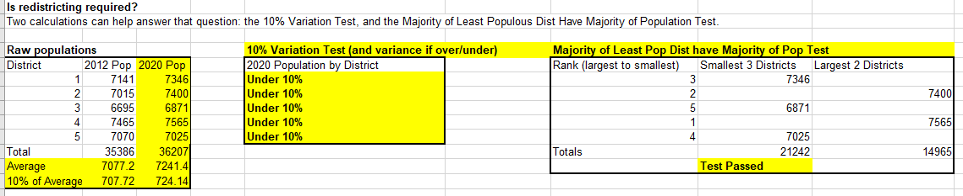
Note: 18 person difference in Districts 4&5 in census block data between LCC information from Secretary of State and State Demographers office. Inconsequential and doesn’t affect the test results. Total of 36,207 is the same in both data sets.
Current Carlton County Commissioner Districts are under the 10% Variation test and meet the Majority test.
The 5% test is met if no changes are made.
Redistricting is not necessary in Carlton County.

Slide 21
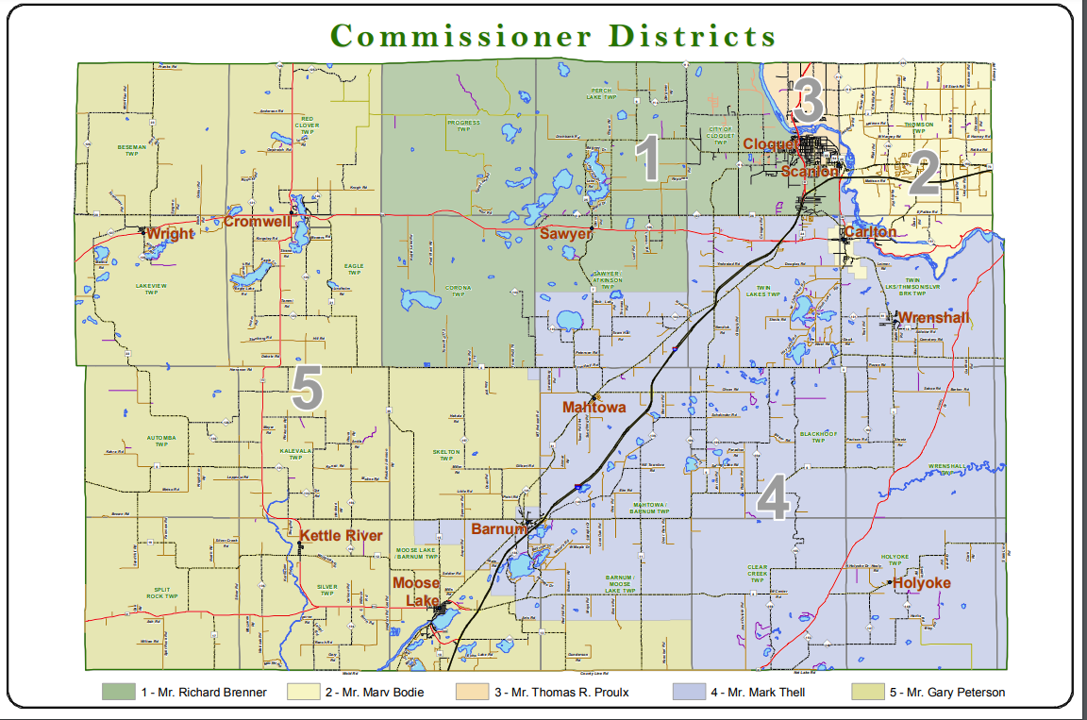

Slide 22
Election of Commissioners
Terms staggered (2 or 4 years)
Method for determining staggered terms
County Board decides
Only necessary if you redistrict

Slide 23
Sources MN Secretary of State https://www.sos.state.mn.us/election-administration-campaigns/election-administration/2021-redistricting-training-and-resources/?searchTerm=redistricting MN State Demographic Center https://mn.gov/admin/demography/data-by-topic/population-data/2020-decennial-census/redistricting/ Questions
Notes:
-----------------------------------------------------------------------------------------------
-----------------------------------------------------------------------------------------------
-----------------------------------------------------------------------------------------------
-----------------------------------------------------------------------------------------------

